Slide 1
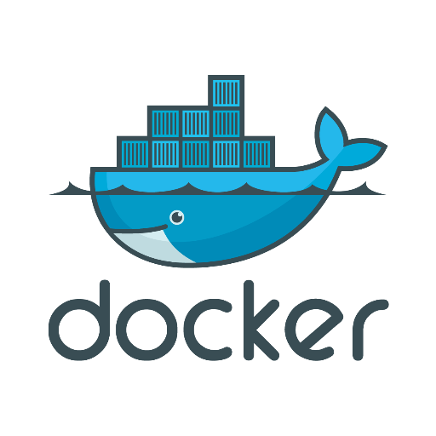
Introduction to Docker

Slide 2
DOCKER HISTORY ……
A dotCloud (PAAS provider) project
Initial commit January 18, 2013
Docker 0.1.0 released March 25, 2013
18,600+ github stars, 3800+ forks,740 Contributors…. and continues
dotCloud pivots to docker inc. October 29, 2013

Slide 3
What is Docker ?!!!
Open platform for developers and sysadmins to build, ship and run distributed applications
Can run on popular 64-bit Linux distributions with kernel 3.8 or later
Supported by several cloud platforms including Amazon EC2, Google Compute Engine, and Rackspace.

Slide 4
Features….
Light-Weight
Minimal overhead (cpu/io/network)
Based on Linux containers
Uses layered filesystem to save space (AUFS/LVM)
Uses a copy-on-write filesystem to track changes
Portable
Can run on any Linux system that supports LXC (today).
0.7 release includes support for RedHat/Fedora family.
Raspberry pi support.
Future plans to support other container tools (lmctfy, etc.)
Possible future support for other operating systems (Solaris, OSX, Windows?)
Self-sufficient
A Docker container contains everything it needs to run
Minimal Base OS
Libraries and frameworks
Application code
A docker container should be able to run anywhere that Docker can run.

Slide 5
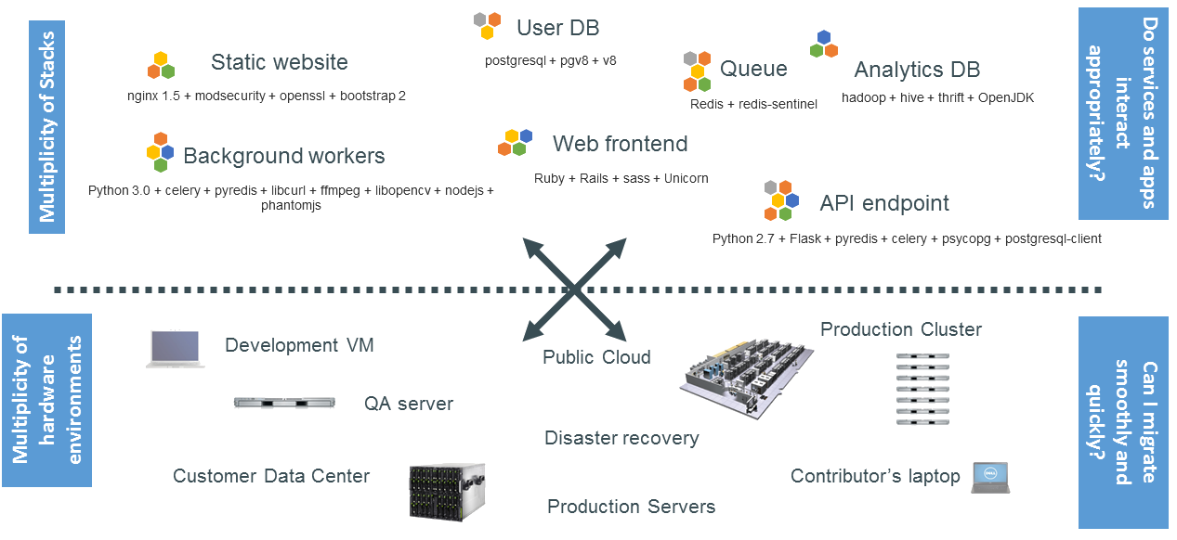
The Challenge……

Slide 6
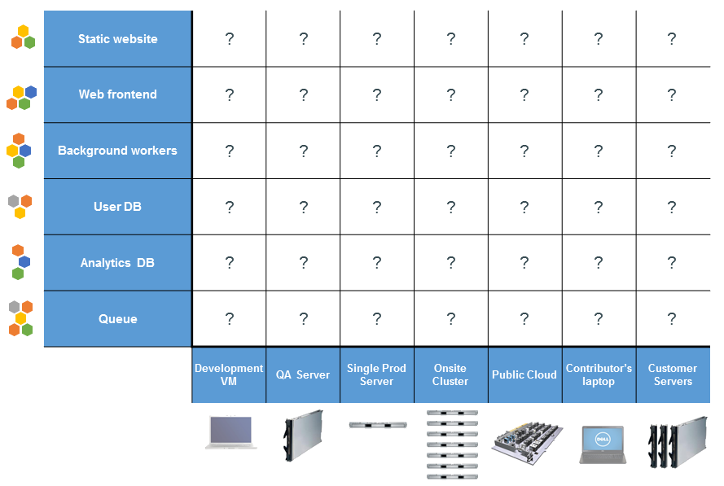
The Matrix From Hell……

Slide 7
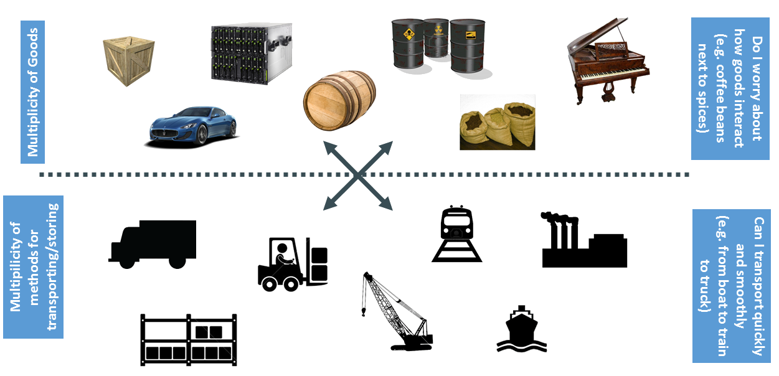
Cargo Transport Pre-1960……

Slide 8
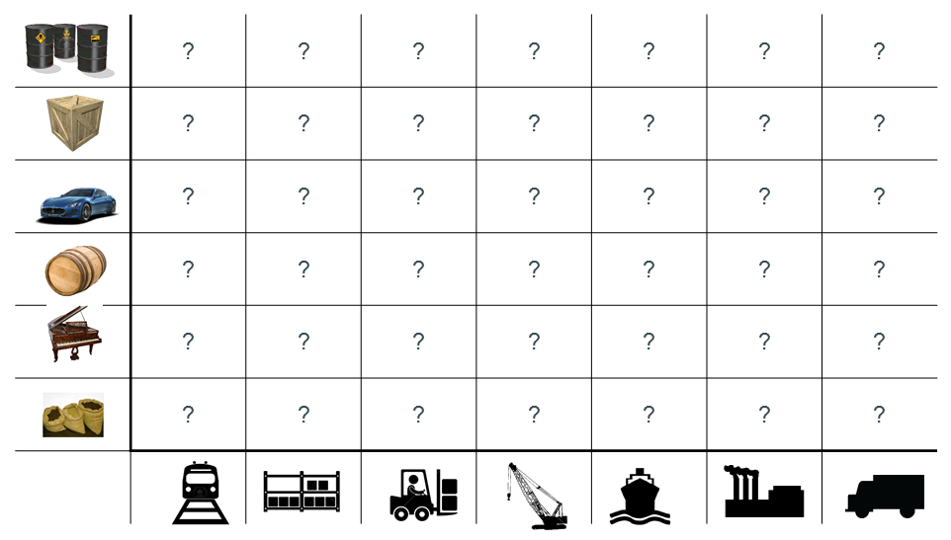
Also a Matrix from Hell……

Slide 9
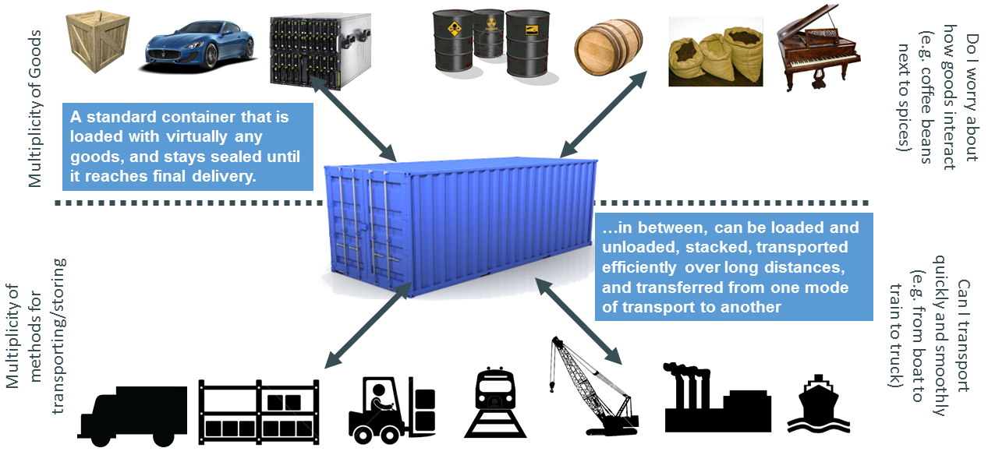
Solution: Intermodal Shipping Container……

Slide 10
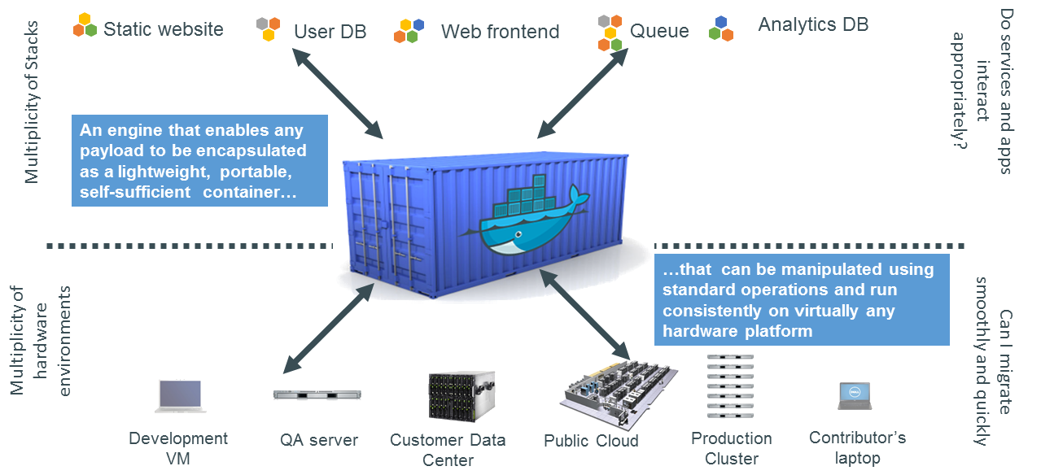
Docker is a Container System for Code……

Slide 11
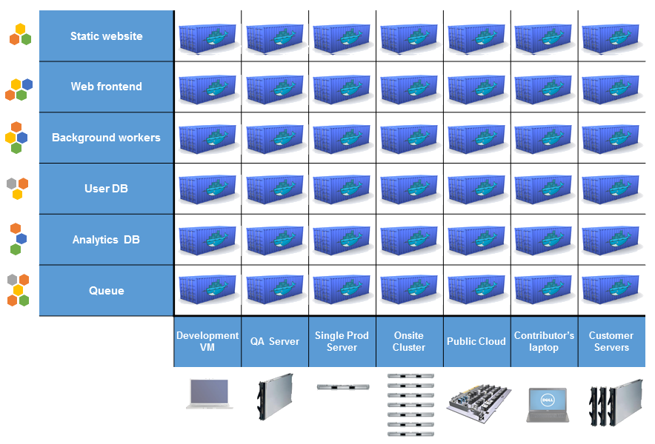
Docker Eliminates the Matrix from Hell……

Slide 12
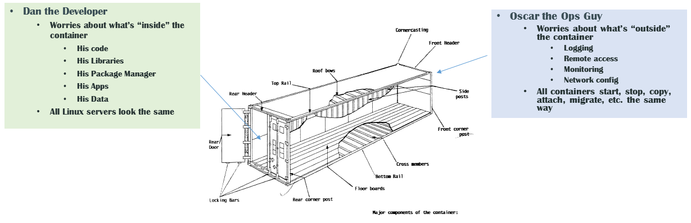
Why it Works: Separation of Concerns……

Slide 13
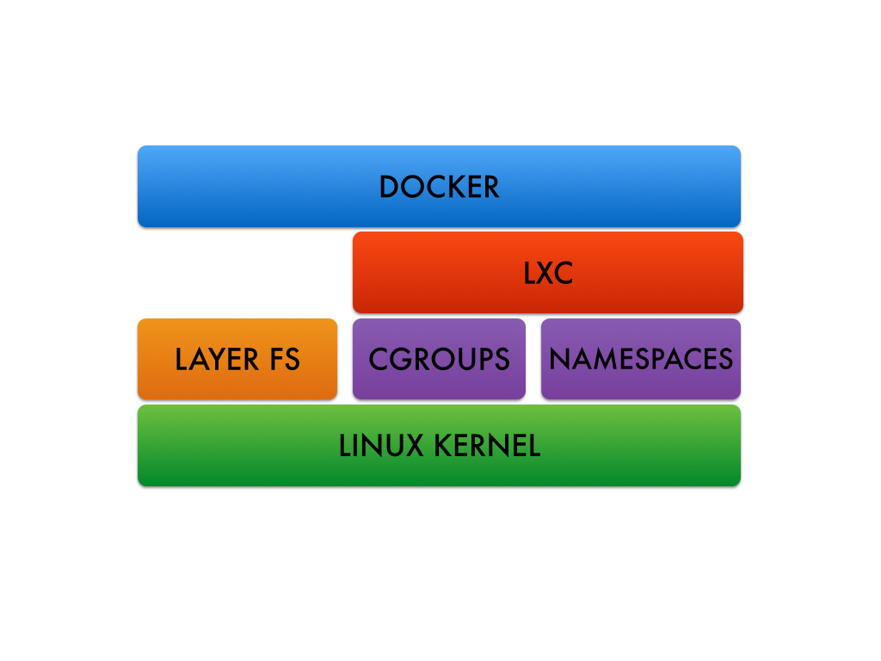
Docker Architecture……
• Docker Engine
– CLI
– Docker Daemon
– Docker Registry
• Docker Hub
– Cloud service
• Share Applications
• Automate workflows
• Assemble apps from components
Docker images
Docker containers

Slide 14
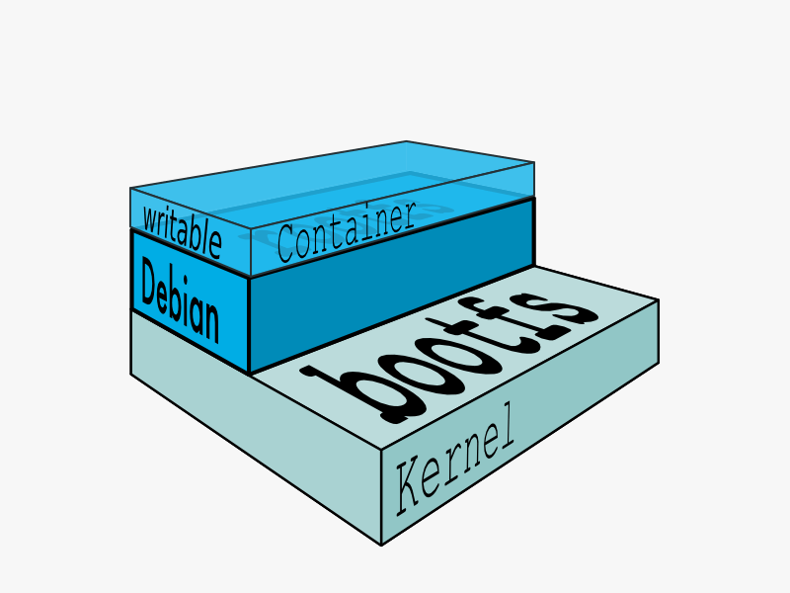
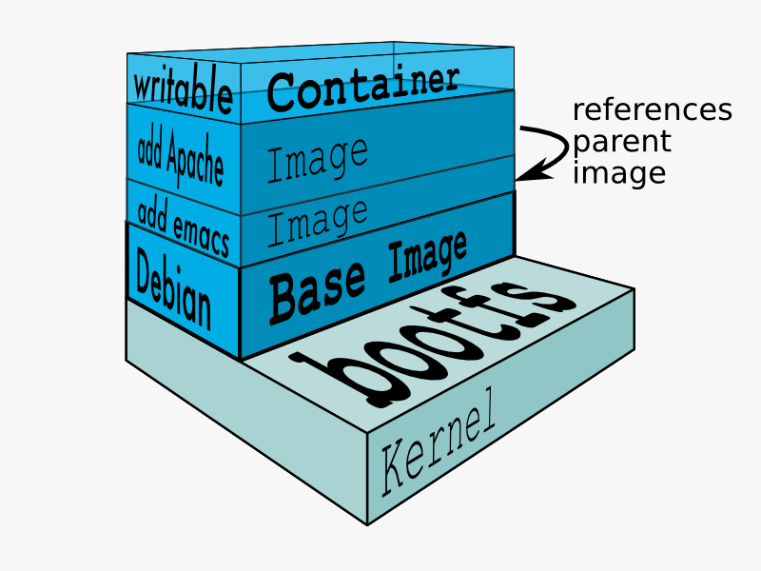
Docker images……
NOT A VHD
NOT A FILESYSTEM
uses a Union File System
a read-only Layer
do not have state
Basically a tar file
Has a hierarchy
• Arbitrary depth
• Fits into the Docker Registry

Slide 15
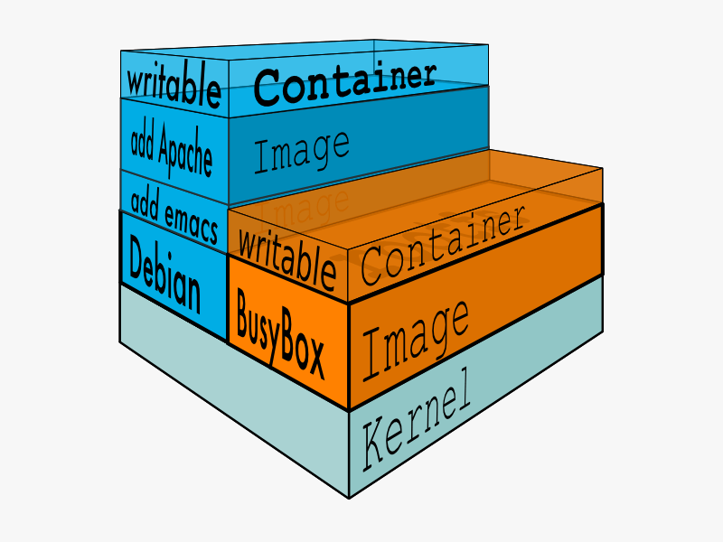
Docker Containers...
Units of software delivery (ship it!)
● run everywhere
– regardless of kernel version
– regardless of host distro
– (but container and host architecture must match*)
● run anything
– if it can run on the host, it can run in the container
– i.e., if it can run on a Linux kernel, it can run
*Unless you emulate CPU with qemu and binfmt

Slide 16
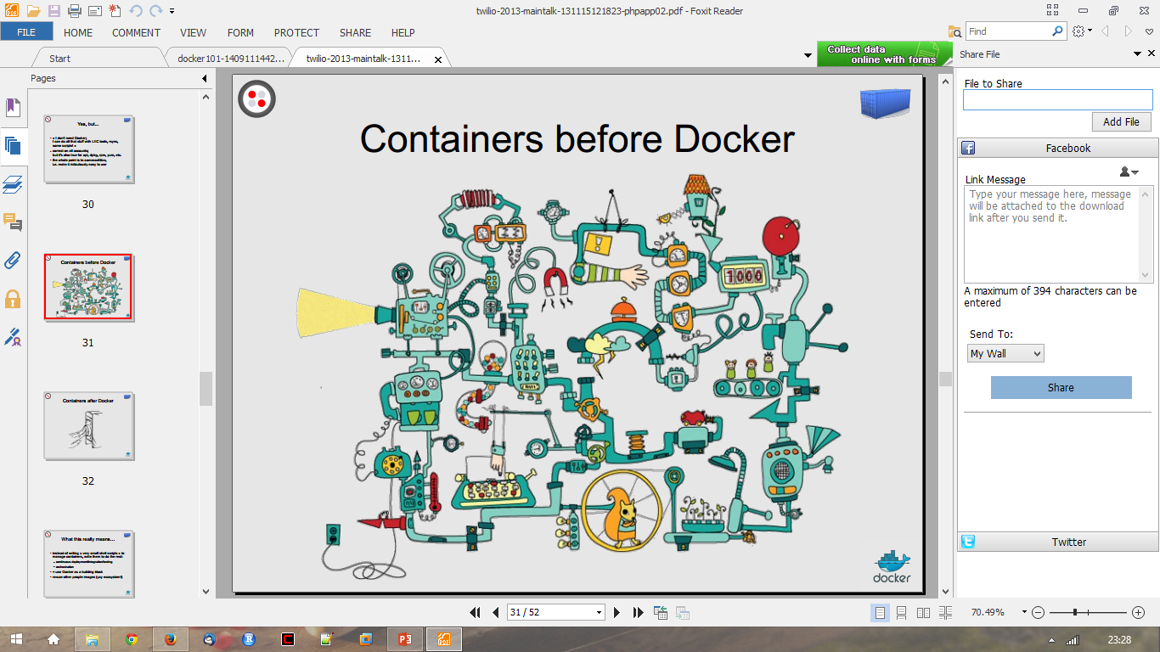
Containers before Docker……

Slide 17
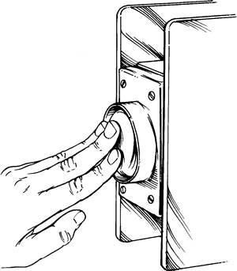
Containers after Docker ……

Slide 18
How does Docker work ?
You can build Docker images that hold your applications
You can create Docker containers from those Docker images to run your applications.
You can share those Docker images via Docker Hub or your own registry

Slide 19
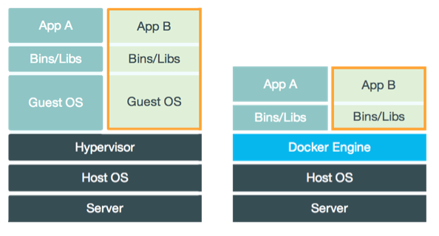
Virtual Machine Versus Container……

Slide 20
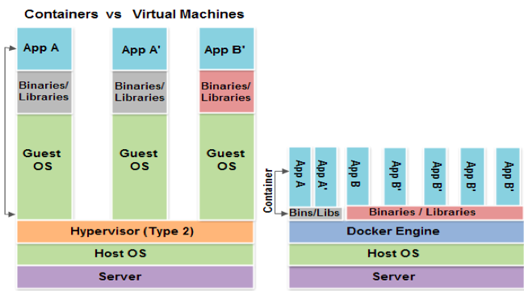
Virtual Machine Versus Container……

Slide 21
Docker Container Lifecycle ……
• The Life of a Container
– Conception
• BUILD an Image from a Dockerfile
– Birth
• RUN (create+start) a container
– Reproduction
• COMMIT (persist) a container to a new image
• RUN a new container from an image
– Sleep
• KILL a running container
– Wake
• START a stopped container
– Death
• RM (delete) a stopped container
• Extinction
– RMI a container image (delete image)

Slide 22
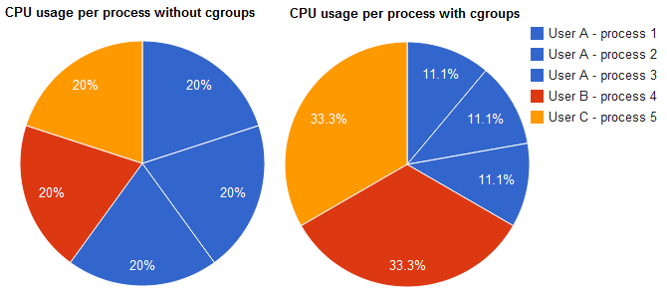
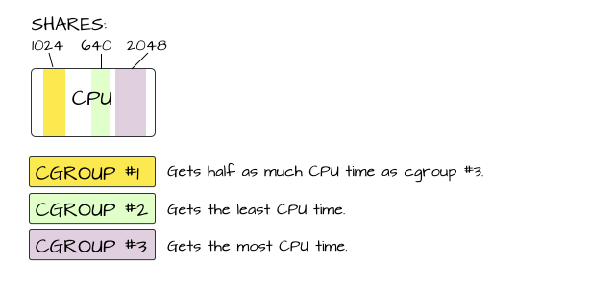
Linux Cgroups ……
• Kernel Feature
• Groups of processes
• Control resource allocations
– CPU
– Memory
– Disk
– I/O
• May be nested

Slide 23
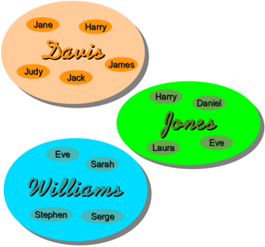
Linux Kernel Namespaces ……
• Kernel Feature
• Restrict your view of the system
– Mounts (CLONE_NEWNS)
– UTS (CLONE_NEWUTS)
• uname() output
– IPC (CLONE_NEWIPC)
– PID (CLONE_NEWPID)
– Networks (CLONE_NEWNET)
– User (CLONE_NEWUSER)
• Not supported in Docker yet
• Has privileged/unprivileged modes today
• May be nested

Slide 24
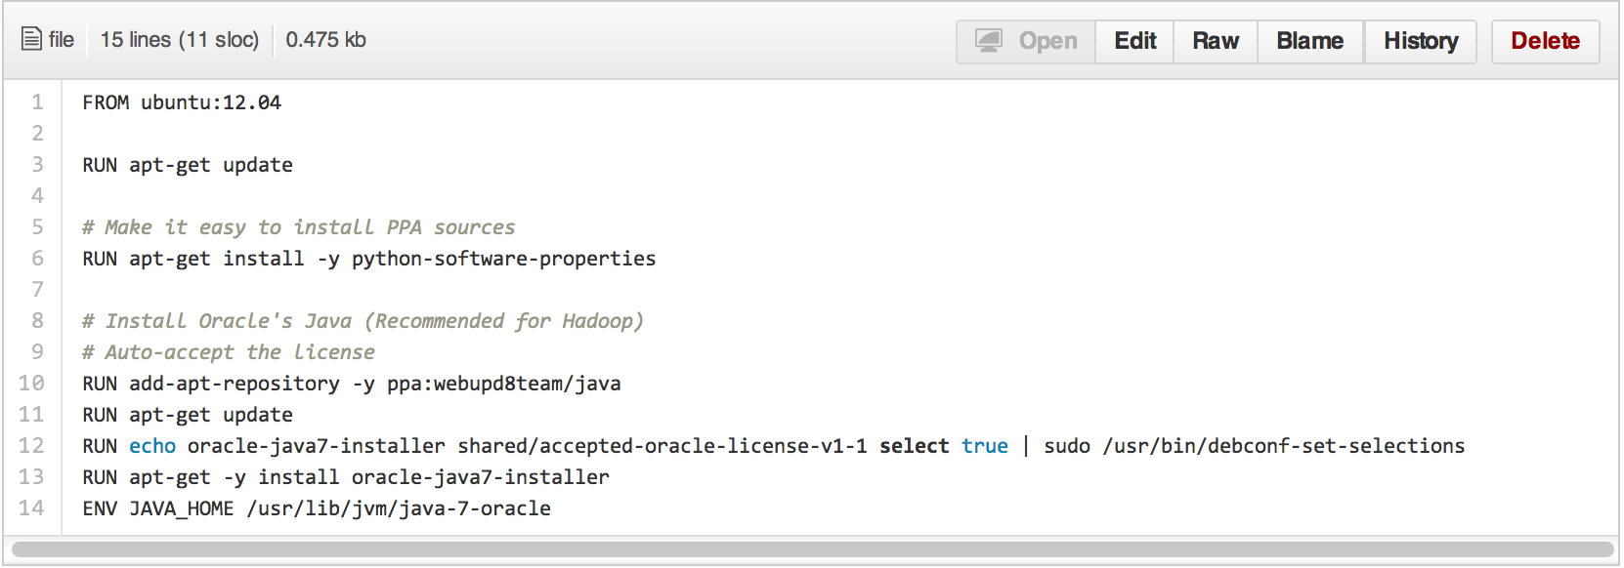
Dockerfile ……
• Like a Makefile (shell script with keywords)
• Extends from a Base Image
• Results in a new Docker Image
• Imperative, not Declarative
A Docker file lists the steps needed to build an images
• docker build is used to run a Docker file
• Can define default command for docker run, ports to expose, etc

Slide 25
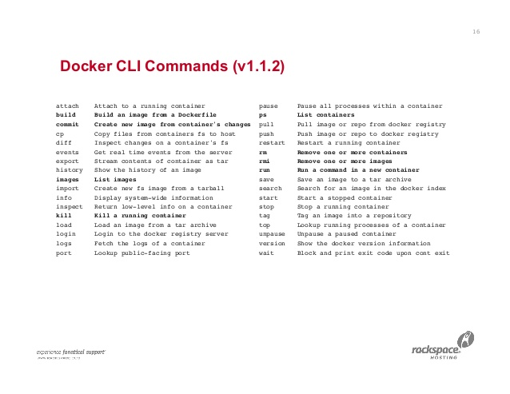
Docker CLI Commands (v1.1.2)……

Slide 26
Contributing to Docker ……
Want to hack on Docker ?
Reporting Security Issues
Design and Cleanup Proposals
Reporting Issues
Build Environment

Slide 27
SUMMARY……
Easy to build, run & share containers
Rapidly expanding ecosystem
Better performance vs. VMs
Layered file system gives us git-like control of images
Reduces complexity of system builds
Red Hat - Project Atomic Host, and certifications - containerized applications, Geard and OpenShift.
Google is expected to tightly integrate containers with its IaaS and PaaS offerings.

